Slide 1
PROJECT DONE FOR :
MICROPROCESSOR AND INTERFACING
COURSE CODE : CSE2006
TEACHER : SWETHA B THOMAS
SLOT : G1

Slide 2
ECG BASED HEART RATE MONITORING SYSTEM USING ARDUINO
Fall Semester 2021-22
Done by
V.Venkata narendra - 18BCE0515
B Sai Koushik - 18BCE0961
Sai Nikhil Reddy M -18BCE0527
Harsha Vardan Kamal -18BCE0983
Mugilan T - 18BCE0946

Slide 3
Abstract :-
World Health Organization (WHO) researchshows that most people die due to heart disease. The basic parameters, which are monitored by a human regularly to keep track of their health, are Heart rate, body temperature and blood pressure. We can easily track/diagnose any abnormal heart activity, indicating to possible heart problems in an early stage by monitoring the ECG signal. Hence, constant tracking of heart rate rhythm can help in identifying heart problems due to any abnormal waves. This paper presents a method to create an ECG based Heart Rate Monitoring System using Arduino with a temperature sensor which will display the heart wave on a monitor (screen) and also the body temperature. This has application in portable ECG remote health monitors and fitness and heart rate monitors.

Slide 4
Introduction :-
Heart rate is one of the most frequently measured parameters of the human body and plays an important role in determining an individual’s health. Heart rate measurement is becoming a part of the typical consumer lifestyle, and many electronic devices. World Health Organization (WHO) research also shows that the most people was dying due to heart disease. The cardiovascular abnormality is one of the biggest causes of deaths among people of all races around the globe especially in the case of old age people. In few years, it is expected that the world population of age 65 and older would exceed the population of the world with age of 15 years.

Slide 5
Cont..
Therefore, this disease cannot be taken lightly. Hence, most health care equipment and monitoring system are designed to keep track the disease. In some countries, people still do not have access to quality health facilities owing to different barriers. This project can help people in rural and remote areas who are far away from hospital or any medical healthcare to take care of their health. Health monitoring of a patient distantly has become an easy and plausible task with the advent of this technology. A heart rate monitor is a personal monitoring device that allows a person to measure the heart rate in real time or record for later study. This also has application in portable ECG remote health monitors and fitness and heart rate monitors. So with the development of this system the elder patients will have the facility to get them diagnosed from the comfort of their home without traveling to hospitals.

Slide 6
Components :-
1. Arduino UNO
2. Heart Beat sensor module
3. 16x2 LCD Display
4. Push button
5. Bread board
6. Power
7. Connecting wires
8. Resistor of 330Ω

Slide 7
Working of Heartbeat Monitor Project :-
Working of this project is quite easy but a little calculation for calculating heart rate is required. There are several methods for calculating heart rate, but here we have read only five pulses. Then we have calculated total heart beat in a minute by applying the below formula:
Five_pusle_time = time2-time1;
Single_pulse_time = Five_pusle_time /5;
Rate = 60000/ Single_pulse_time;
where time1 is first pulse counter value
time 2 is list pulse counter valuerate is final heart rate.

Slide 8
Cont..
When first pulse comes, we start counter by using timer counter function in arduino that is millis();. And take first pulse counter value form millis();. Then we wait for five pulses. After getting five pulses we again take counter value in time 2 and then we subtract time1 from time 2 to take original time taken by five pulses. And then divide this time by 5 times for getting single pulse time. Now we have time for single pulse and we can easily find the pulse in one minute, dividing 600000 ms by single pulse time.
Rate= 600000/single pulse time.
In this project we have used Heart beat sensor module to detect Heart Beat. This sensor module contains an IR pair which actually detect heart beat from blood. Heart pumps the blood in body which is called heart beat, when it happens the blood concentration in body changes. And we use this change to make a voltage or pulse electrically.

Slide 9
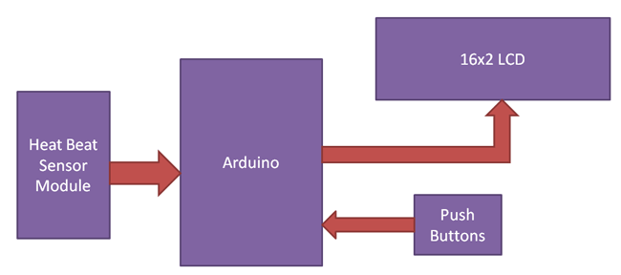
PROPOSED ARCHITECTURE DIAGRAM :-

Slide 10
Circuit Diagram and Explanation :-
Circuit of heartbeat monitor is shown below, which contains arduino uno, heart beat sensor module, reset button and LCD. Arduino controls whole the process of system like reading pulses form Heart beat sensor module, calculating heart rate and sending this data to LCD. We can set the sensitivity of this sensor module by inbuilt potentiometer placed on this module.

Slide 11
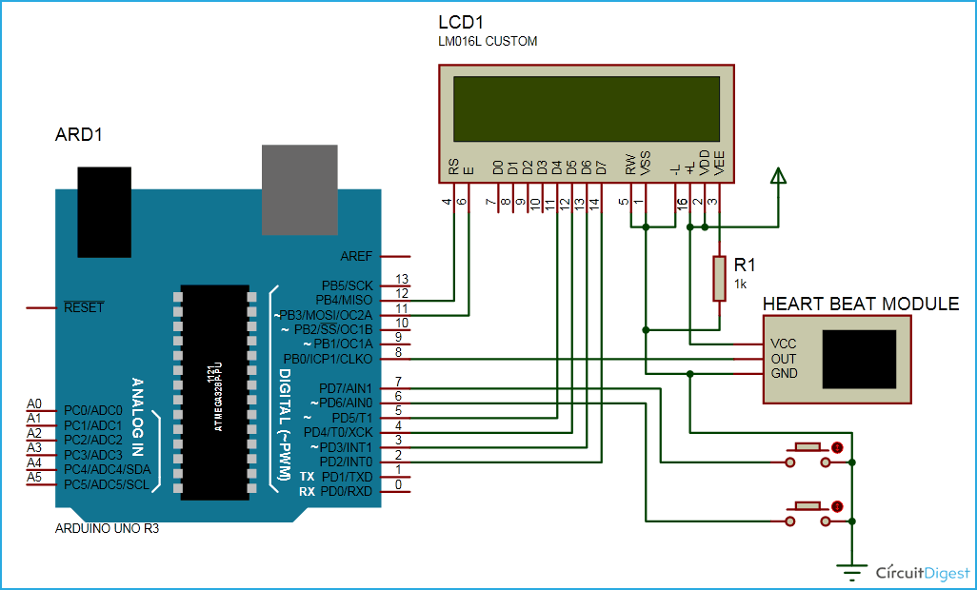
Cont..

Slide 12
Cont..
Heart beat sensor module’s output pin is directly connected to pin 8 of arduino. Vcc and GND are connected to Vcc and GND. A 16x2 LCD is connected with arduino in 4-bit mode. Control pin RS, RW and En are directly connected to arduino pin 12, GND and 11. And data pin D4-D7 is connected to pins 5, 4, 3 and 2 of arduino. And one push button is added for resetting reading and another is used to start the system for reading pulses. When we need to count heart rate, we press start button then arduino start counting pulses and also start counter for five seconds. This start push button is connected to pin 7 and reset push button is connected to pin 6 of arduino with respect to ground

Slide 13
Conclusion and future scope :-
This device allows a person to measure the heart rate in real time or record for later study. This also has application in portable ECG remote health monitors and fitness and heart rate monitors. So with the development of this system the elder patients will have the facility to get them diagnosed from the comfort of their home without traveling to hospital or in the situation where there is a dire need to visit the hospital in case of abnormalities that are detected on the device and after future developments might be able to send required information to nearby hospital facility about incoming patient and precautions to be taken and thus by eliminating potential risk of death

Slide 14
References :-
[1] M. J Drinnan, J. Allen, and A. Murray (2001). "Relation between heart rate and pulse transit time during paced respiration", Physiol. Meas. vol. 22, pp425–432.
[2] “Range of Heart Rates per Minute and Average Heart Rate for Various Ages”. Retrieve on 7th December 2008 (http://www.smm.org/heart/lessons/lesson1.htm)
[3] Allen J. (2007). “Photoplethysmography and its application in clinical physiological measurement”, Physiol Meas. 2007 Mar; 28(3):R1-39. Epub 2007 Feb 20
[4] Shelley, K. H., R. G. Stout, et al. (1999). "The Use of Joint Time Frequency Analysis of The Pulse Oximeter Waveform to Measure The Respiratory Rate of Ventilated Patients." Anesthesiology 91(3A): A583.
[5] Péter Csordàs, Balázs Scherer (2006), “Development and Applications of A Home Health Monitoring Device”, Proc. of International Carpathian Control Conference ICCC’ 2006, May 29-31
and rest are mentioned in report.....

